Slide 1
Discussion 8
Scheme
Jason Zhou | Section 136
CS61A Spring 2019

Slide 2
Announcements
Today: Lab 09

Slide 3
Agenda
Misc. Ideas for Proj 4
Project EC prep
Scheme Practice
Scheme Exam Prep

Slide 4
CS61A: The Structure & Interpretation of Computer Programs
Weeks 1 - 9 | Fundamentals | Python
Functions, Control, Recursion, Trees, Data, Classes, etc.
Weeks 9 - 12 | Interpretation | Scheme
Interpreters, Tail Calls, Macros, Streams, etc.
Weeks 12 - 15 | Declarative Programming | SQL
Databases, Aggregation, Distributed Computing, Extra Topics

Slide 5
Why Scheme?
Historical Reasons:
Trees, data storage, high-order functions, recursion, read-eval-print loop
CS 61A
Simplicity:
Well-defined framework built upon parentheses & special forms
Easy to understand & implement its interpretation (Project 4)
Programming Paradigms:
Functional vs. Imperative vs. Declarative Programming

Slide 6
Functional vs. Imperative Programming
Scheme → Functional Programming Language
Treat everything as mathematical expressions (no statements i.e. x = 1)
Symbolic computation
Immutable values
Python → Imperative Programming Language
Manually direct the flow of program
Statements
Mutable values

Slide 7
Functional vs. Imperative Programming
Python:
if predicate: true-action
else:
false-action
Scheme:
(if pred true-action false-action)
Evaluates to a value

Slide 8
Interpreted Languages
Python: Interpreted Language
Lines of Python code → Execute program → Output/Action
Python program → Passed in as input to a C program → Output
Intermediary C program: Python Interpreter (CS 164)
Scheme: Interpreted Language
Lines of Scheme code → Execute program → Output/Action
Scheme program → Passed in as input to a Python program → Output
Intermediary Python program: Scheme Interpreter (CS 61A)

Slide 9
Compiled Languages
C (& Java, CS61B): Compiled Language
Lines of C code → Compile program → Binary → Execute binary file → Output
Compile step: turn C code into raw binary
Intermediary program: Compiler
C compiler is written in C itself (bootstrapping)
Interpreted vs. Compiled: Speed

Slide 10
Proj 4 Scheme
Write a program in Python, that given a program in Scheme, executes the appropriate actions.
Keeping track of environment variables, functions, recursive calls, etc.
Parsing/Tokenizing (breaking down a long string into understandable parts)
(define x 1) → [“define”, “x”, “1”]
Read-Eval-Print Loop
(+ 3 (- 2 1)) → [“+”, “3”, “(- 2 1)”]
(- 2 1) → [“-”, “2”, “1”] → 1
(+ 3 (- 2 1)) → [“+”, “3”, “(- 2 1)”] → [“+”, “3”, “1”] → 4

Slide 11
Proj 4 Extra Credit: Tail Recursion
def factorial(n):
if (n == 1):
return 1
else:
return n*factorial(n-1)
f1: factorial(3)
return value: 3 * factorial(2)
return value: 3 * 2
f2: factorial(2)
return value: 2 * factorial(1)
return value: 2 * 1
f3: factorial(1)
return value: 1

Slide 12
Proj 4 Extra Credit: Tail Recursion
def factorial(n, answer=1):
if (n == 1):
return answer
else:
return factorial(n-1, answer*n)
f1: factorial(3, 1)
return value: factorial(2, 3*1)
f2: factorial(2, 3)
return value: factorial(1, 3*2*1)
f3: factorial(1, 6)
return value: 6

Slide 13
Scheme Practice

Slide 14
Exam Prep

Slide 15
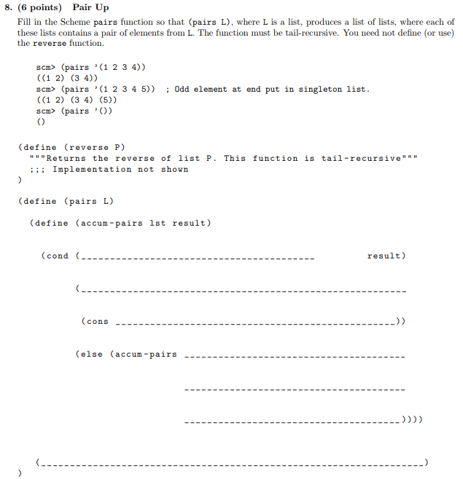

Slide 16
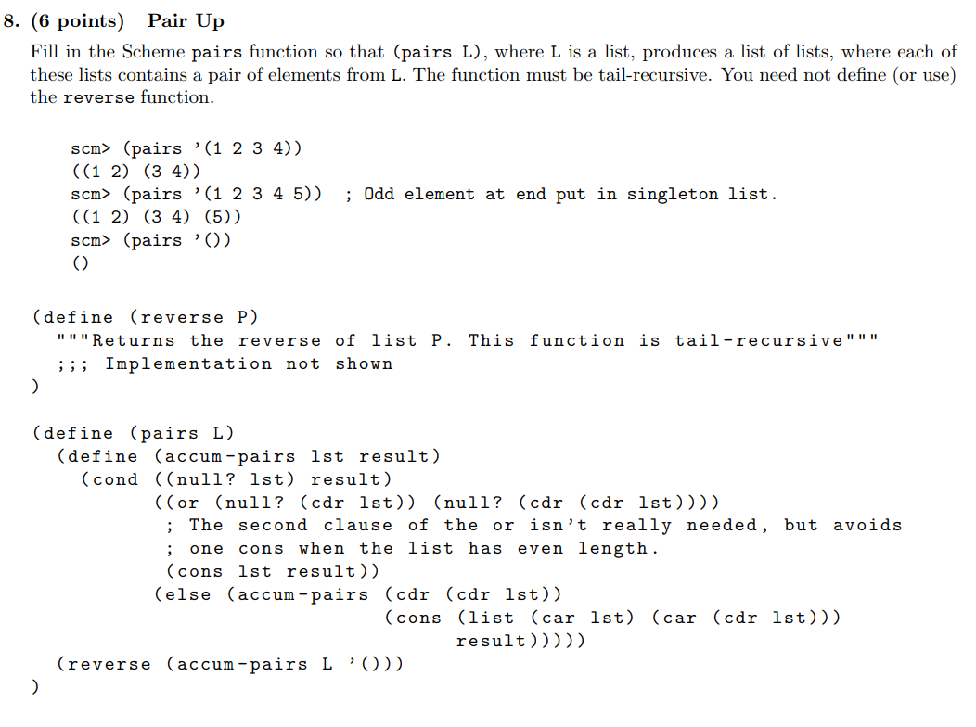

Slide 17
Attendance
links.cs61a.org/jasonz-attendance

